Slide 1



Neural Networks
Knowledge and solutions for a changing world
Advancing data-intensive discovery in all fields
Be boundless
UW DIRECT
(Data Intensive Research Enabling Cutting-edge Tech)
https://uwdirect.github.io
Data Science Methods for Cutting-Edge Research (DSMCER)

Slide 2
Review and future
Congratulations, Arushi!
Questions from last class?
Homework questions?
Poster information (template, logos, $$)
Side note – NN figures in this deck were rendered with graphviz code created in Python https://github.com/UWDIRECT/UWDIRECT.github.io/blob/master/Wi18_content/DSMCER/slidegen/dotgen_dropout.py

Slide 3
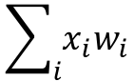
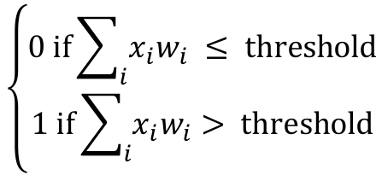
Perceptrons
Proposed by Frank Rosenblatt in early 1960s
First type of `artificial neuron`
Takes n binary inputs
Generates one binary output
x₁
x₂
x₃
x₄
…
x_{n}
w₁
w₂
$$\left\{\begin{aligned}0 \text{if}\sum_{i}{x_{i}w_{i}} ≤ \text{threshold} \\ 1 \text{if}\sum_{i}{x_{i}w_{i}}> \text{threshold}\end{aligned}\right.$$
w₃
$$\sum_{i}{x_{i}w_{i}}$$
w₄
output
w_{n}

Slide 4
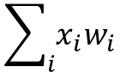
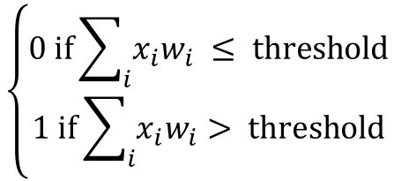
Perceptrons
A molecular example, using this molecule:
Should I have more coffee?
Output is 0 (no) or 1 (yes)
Inputs
Do I currently have a coffee in my hand?
Has it been two hours since my last coffee?
Is it too close to sleepy time?
Don’t have coffee now? x₁
Last coffee > 2 hrs? x₂
Earlier than 6 pm? x₃
$$\left\{\begin{aligned}0 \text{if}\sum_{i}{x_{i}w_{i}} ≤ \text{threshold} \\ 1 \text{if}\sum_{i}{x_{i}w_{i}}> \text{threshold}\end{aligned}\right.$$
$$\sum_{i}{x_{i}w_{i}}$$
output
w₁ = ?
w₂ = ?
w₃ = ?
threshold = ?
Let’s work the example!
Notes:
Need a volunteer to write out the example as we pick weights and a threshold. Experiment with the last coffee weight as it relates to 6pm weight

Slide 5
Multilayer Perceptron
We can layer perceptrons
Note: for each perceptron there is still only one output, but it is fed into multiple other perceptrons in the next layer.

Slide 6
Multilayer Perceptron
We can layer perceptrons
Layer 1 makes very simple decisions based on the raw inputs.
Layer 2 makes abstract and complex decisions based on the layer 1’s results.
Can layer 2 access the raw inputs?

Slide 7
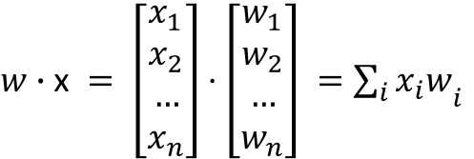
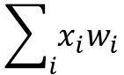
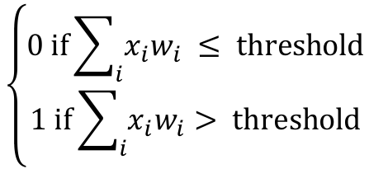
Recall…
The dot product of two vectors
In the context of a perceptron
$w∙\text{x} = \left[\begin{aligned}x_{1} \\ x_{2} \\ … \\ x_{n}\end{aligned}\right]⋅\left[\begin{aligned}w_{1} \\ w_{2} \\ … \\ w_{n}\end{aligned}\right] ={\sum_{i}{x_{i}w}}_{i}$
x₁
x₂
x₃
x₄
…
x_{n}
w₁
w₂
$$\left\{\begin{aligned}0 \text{if}\sum_{i}{x_{i}w_{i}} ≤ \text{threshold} \\ 1 \text{if}\sum_{i}{x_{i}w_{i}}> \text{threshold}\end{aligned}\right.$$
w₃
$$\sum_{i}{x_{i}w_{i}}$$
w₄
output
w_{n}

Slide 8
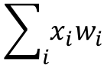
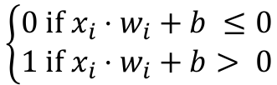
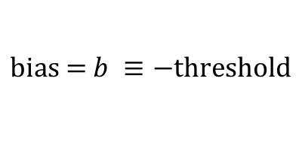
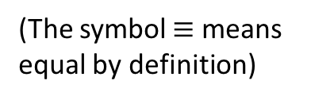
Modifying the perceptron
Let’s rewrite the perception equation in terms of bias
Bias is effectively how easy it is to trigger a 1 (or fire)
(The symbol $≡$ means equal by definition)
$$\text{bias}\text{ = }b ≡−\text{threshold}$$
x₁
x₂
x₃
x₄
…
x_{n}
w₁
w₂
w₃
$$\sum_{i}{x_{i}w_{i}}$$
$$\left\{\begin{aligned}0 \text{if} x_{i}⋅w_{i}+b ≤0 \\ 1 \text{if} x_{i}⋅w_{i}+b> \text{0}\end{aligned}\right.$$
w₄
output
w_{n}

Slide 9
Multilayer Perceptron
We can layer perceptrons
In literature, input are treated as a layer itself

Slide 10
Multilayer Perceptron
We can layer perceptrons
The middle layers are ‘hidden’
The output is a layer and may contain multiple nodes
Hidden layers

Slide 11
Multilayer Perceptron
We can layer perceptrons
Simple MLPs can be constructed for logic functions like AND, OR, NAND – “neural circuitry”
Hidden layers

Slide 12
Multilayer Perceptron
Learning with MLPs
If our output is incorrect by some Δoutput
Ideally we want to find a Δw_{i} that modifies output
In practice this is hard. Why?
Hint:
Random internet image

Slide 13
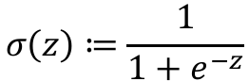
The sigmoid function
What if we had a smoother transition?
The sigmoid function
Outputs only values from 0 to 1
Monotonic, increasing, differentiable
$$σ\left(z\right)≔\frac{1}{1+e^{−z}}$$
Wikipedia

Slide 14
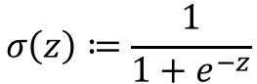
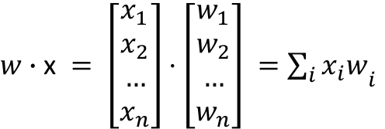
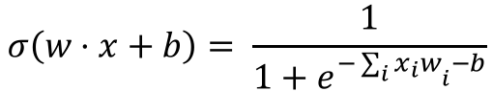
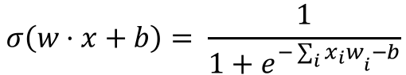
Sigmoid neuron
Use the sigmoid as out activation function
$w∙\text{x} = \left[\begin{aligned}x_{1} \\ x_{2} \\ … \\ x_{n}\end{aligned}\right]⋅\left[\begin{aligned}w_{1} \\ w_{2} \\ … \\ w_{n}\end{aligned}\right] ={\sum_{i}{x_{i}w}}_{i}$
$$σ\left(z\right)≔\frac{1}{1+e^{−z}}$$
$$σ\left(w⋅x+b\right)= \frac{1}{1+e^{−{\sum_{i}{x_{i}w}}_{i}−b}}$$
x₁
x₂
x₃
x₄
…
x_{n}
w₁
w₂
w₃
$$σ\left(w⋅x+b\right)= \frac{1}{1+e^{−{\sum_{i}{x_{i}w}}_{i}−b}}$$
w₄
output
w_{n}

Slide 15
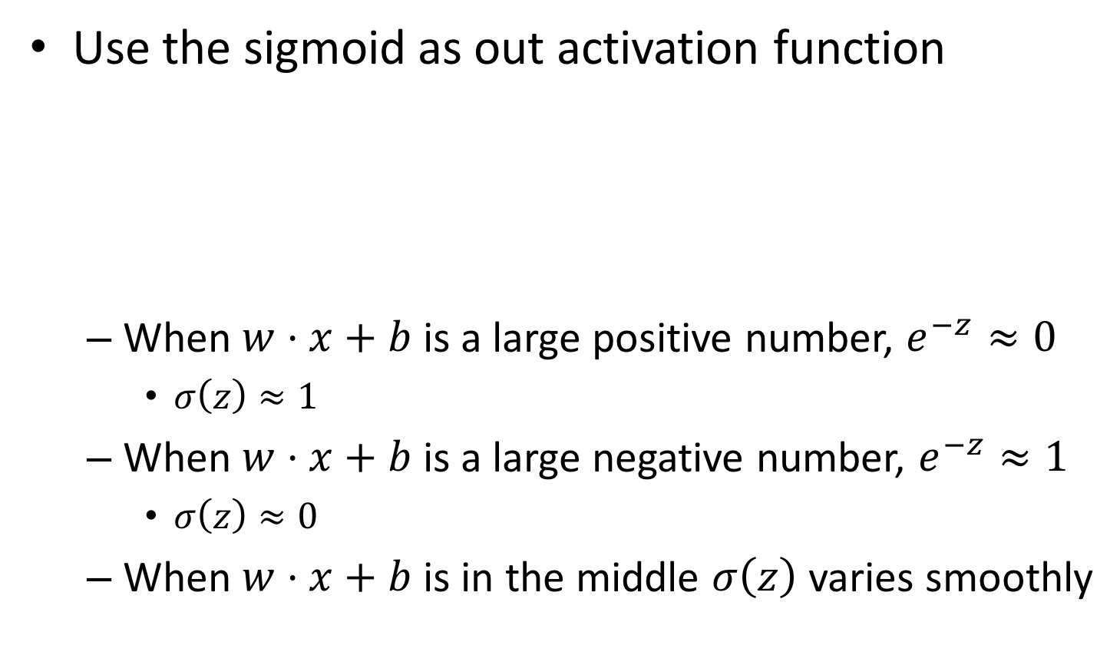
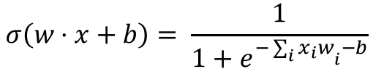
Sigmoid neuron
Use the sigmoid as out activation function
When $w⋅x+b$ is a large positive number, $e^{−z}≈0$
$σ\left(z\right)≈1$
When $w⋅x+b$ is a large negative number, $e^{−z}≈1$
$σ\left(z\right)≈0$
When $w⋅x+b$ is in the middle $σ\left(z\right)$ varies smoothly
x₁
x₂
x₃
x₄
…
x_{n}
w₁
w₂
w₃
$$σ\left(w⋅x+b\right)= \frac{1}{1+e^{−{\sum_{i}{x_{i}w}}_{i}−b}}$$
w₄
output
w_{n}

Slide 16
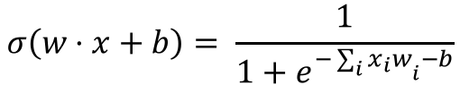
Neural network
We can layer sigmoid neurons
x₁
x₂
x₃
x₄
…
x_{n}
w₁
w₂
w₃
$$σ\left(w⋅x+b\right)= \frac{1}{1+e^{−{\sum_{i}{x_{i}w}}_{i}−b}}$$
w₄
output
w_{n}

Slide 17
Neural network
This is a strictly ‘feed forward network’
Layers only propagate forward in the hierarchy

Slide 18
Neural network
Recurrent neural networks allow loops
Loops allow for time delays
Can be used for sequence prediction
Not just in time
Protein / DNA sequence, i.e.
Heteropolymer sequence
Structural states
…
Elman network, wikipedia

Slide 19
Neural network structure
Input, hidden, output
How many input nodes do we need?
64 pixel by 64 pixel single channel input
64 pixel by 64 pixel multi-channel input
Hidden layer count?
Nodes per hidden layer?
Output nodes?
Structured or unstructured
Structured, semi-structured, unstructured

Slide 20
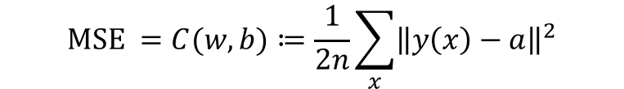
Learning in neural networks
Let’s define a cost function that is our MSE
Where w and b are the vectors of weights and biases collectively
n is the number of training samples in set x
a is the vector of predictions from our network
y(x) is the vector of labels (i.e. training observations)
Our goal in learning is to minimize this cost
$$\text{MSE} =C(w,b)≔\frac{1}{2n}\sum_{x}{{\left\|y\left(x\right)−a\right\|}^{2}}$$
Notes:
1/2n makes this a quadratic cost function

Slide 21
Learning in neural networks
Our goal in learning is to minimize the C function
We have analytical, differential forms for all components
Find an analytical solution!

Slide 22
Learning in neural networks
Our goal in learning is to minimize the C function
In practice, for most sets of w and b this is impractical
Gradient descent methods are used
Iterative process
Numerically compute the gradients of each component of w and b vectors relative to C
Select the component with the largest gradient
Change it by some value 𝜀
Rinse – repeat until converged

Slide 23
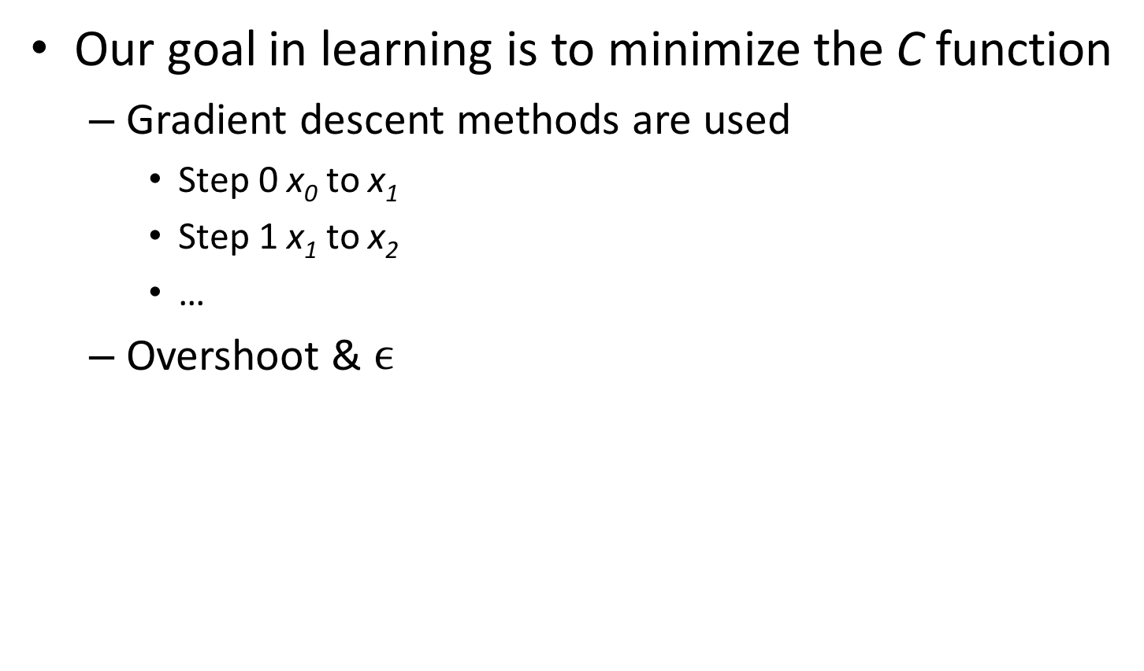
Learning in neural networks
Our goal in learning is to minimize the C function
Gradient descent methods are used
Step 0 x₀ to x₁
Step 1 x₁ to x₂
…
Overshoot & $ϵ$
wikipedia

Slide 24
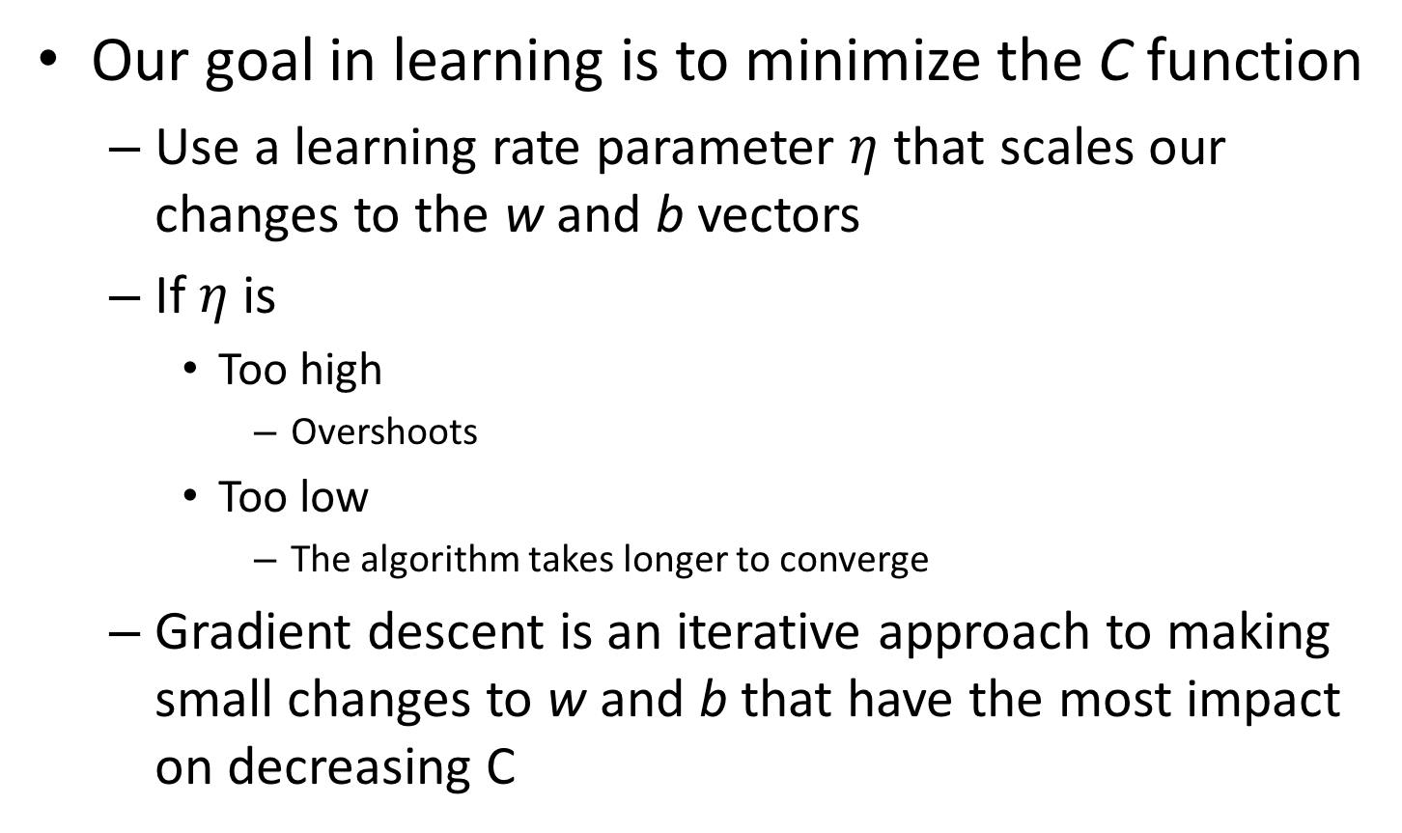
Learning in neural networks
Our goal in learning is to minimize the C function
Use a learning rate parameter $η$ that scales our changes to the w and b vectors
If $η$ is
Too high
Overshoots
Too low
The algorithm takes longer to converge
Gradient descent is an iterative approach to making small changes to w and b that have the most impact on decreasing C

Slide 25
Learning in neural networks
Our goal in learning is to minimize the C function
Stochastic gradient descent can speed up learning
Select a random subset of training samples where n is large enough to get a good estimate of the gradients of w and b relative to C
Note: again, we have a case where we want to down sample while trying to maintain an accurate estimator
Perform a step of gradient descent minimization of C against w and b
Rinse, repeat for some number of mini-batches and when complete, call it an epoch

Slide 26
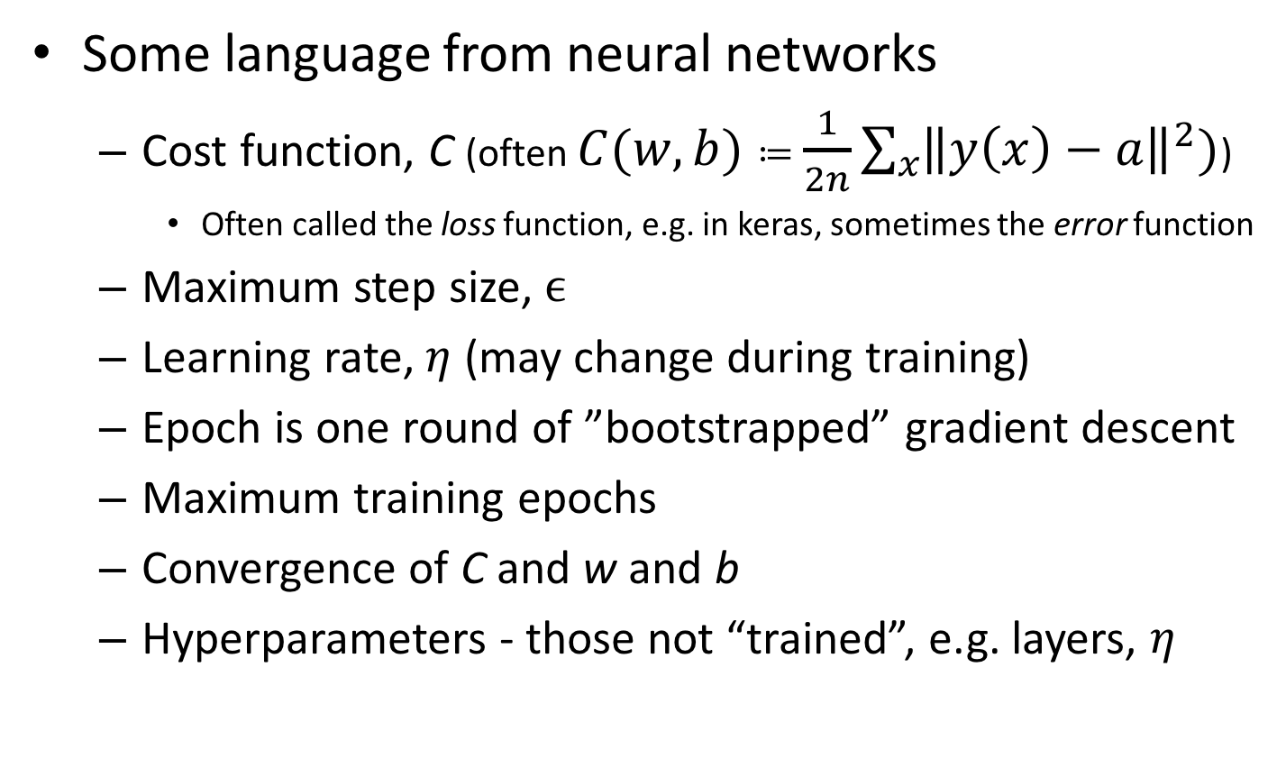
Learning in neural networks
Some language from neural networks
Cost function, C (often $C(w,b)≔\frac{1}{2n}\sum_{x}{{\left\|y\left(x\right)−a\right\|}^{2}})$)
Often called the loss function, e.g. in keras, sometimes the error function
Maximum step size, $ϵ$
Learning rate, $η$ (may change during training)
Epoch is one round of ”bootstrapped” gradient descent
Maximum training epochs
Convergence of C and w and b
Hyperparameters - those not “trained”, e.g. layers, $η$

Slide 27
Learning in neural networks
Our goal in learning is to minimize the C function
In practice, for most sets of w and b this is impractical
Gradient descent methods are used
Iterative process
Numerically compute the gradients of each component of each vector relative to C
Select the component with the largest gradient
Change it by some value 𝜀
Rinse – repeat until converged

Slide 28
Learning in neural networks
Our goal in learning is to minimize the C function
In practice, for most sets of w and b this is impractical
Gradient descent methods are used
Iterative process
Numerically compute the gradients of each component of w and b vectors relative to C
Select the component with the largest gradient
Change it by some value 𝜀
Rinse – repeat until converged
Backpropagation
Partial differential of C with respect to w & b

Slide 29
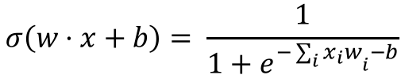
Limitations of sigmoids
Learning slows down at sigmoid asymptotes
The partial differential of C with respect to w & b is very small near 0 and 1
Large changes in w_{i} & b_{i} have little effect on C
$$σ\left(w⋅x+b\right)= \frac{1}{1+e^{−{\sum_{i}{x_{i}w}}_{i}−b}}$$

Slide 30
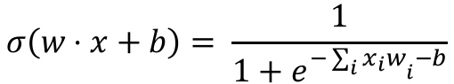
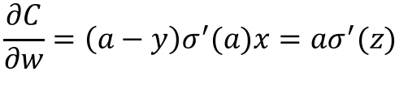
Limitations of sigmoids
Learning slows down at sigmoid asymptotes
$$σ\left(w⋅x+b\right)= \frac{1}{1+e^{−{\sum_{i}{x_{i}w}}_{i}−b}}$$
$$\frac{∂C}{∂w}=\left(a−y\right)σ^{′}(a)x=aσ^{′}(z)$$
Derivative of σ @ z
Also known as saturation or vanishing gradient problem.

Slide 31
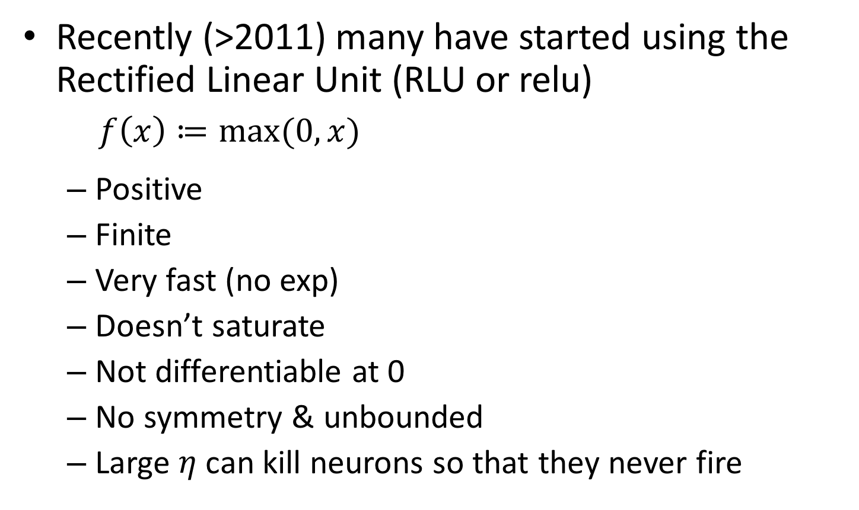
Activation alternatives
Recently (>2011) many have started using the Rectified Linear Unit (RLU or relu)
$f\left(x\right)≔\max_{}{(0, x)}$
Positive
Finite
Very fast (no exp)
Doesn’t saturate
Not differentiable at 0
No symmetry & unbounded
Large $η$ can kill neurons so that they never fire
Wikipedia

Slide 32
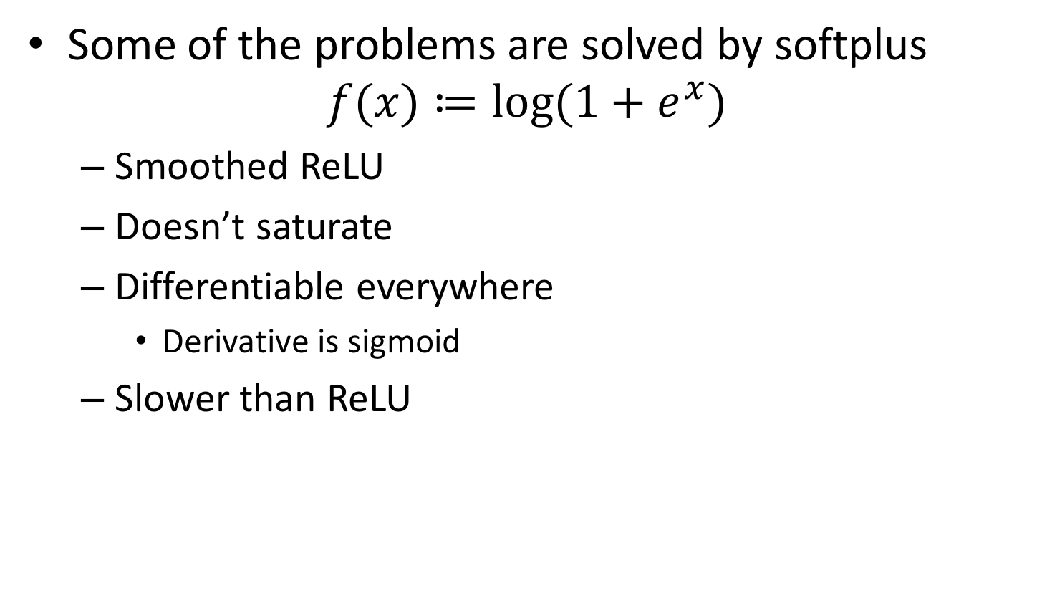
Activation alternatives
Some of the problems are solved by softplus
$$f(x)≔log⁡(1+e^{x})$$
Smoothed ReLU
Doesn’t saturate
Differentiable everywhere
Derivative is sigmoid
Slower than ReLU
Wikipedia

Slide 33
Limitations of sigmoids
Learning slows down at sigmoid asymptotes
$$σ\left(w⋅x+b\right)= \frac{1}{1+e^{−{\sum_{i}{x_{i}w}}_{i}−b}}$$
$$\frac{∂C}{∂w}=\left(a−y\right)σ^{′}(a)x=aσ^{′}(z)$$
Derivative of σ @ z
Another solution…. Change the cost function!

Slide 34
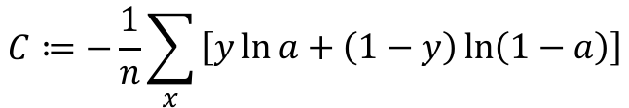
A better cost function
for classification
A new cost function, cross-entropy
n is the number of samples in the training set
a is the prediction for the a given sample x
y is the observed value for the sample x
Note: this function is always positive
Negative sum over elements of ln which are negative
Inputs to ln are always 0 to 1 (a & 1 – a)
$$C≔−\frac{1}{n}\sum_{x}{\begin{aligned}\left[y\ln{a}+\left(1−y\right)\ln\left(1−a\right)\right]\end{aligned}}$$

Slide 35
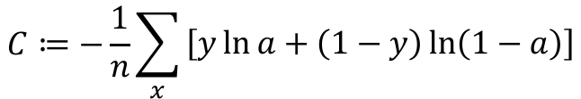
A better cost function
for classification
A new cost function, cross-entropy
How is this a cost function?
When y and a are about equal and close to 0
The first term vanishes as does the second (0 * ln(anything) = 0)
When y and a are about equal and close to 1
The first term vanishes as does the second (anything * ln(1) = 0)
Thus, cross-entropy cost is positive and drives to 0 as the predictions approximate the training observations
$$C≔−\frac{1}{n}\sum_{x}{\begin{aligned}\left[y\ln{a}+\left(1−y\right)\ln\left(1−a\right)\right]\end{aligned}}$$

Slide 36
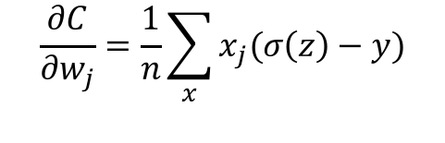
A better cost function
for classification
Why is this cost function better?
The partial derivatives of C with respect to w and b contain no reference to the sigmoid function!
$$\frac{∂C}{∂w_{j}}=\frac{1}{n}\sum_{x}{x_{j}(σ\left(z\right)−y)}$$
Note: dependence only on error in output and not derivative of sigmoid!

Slide 37
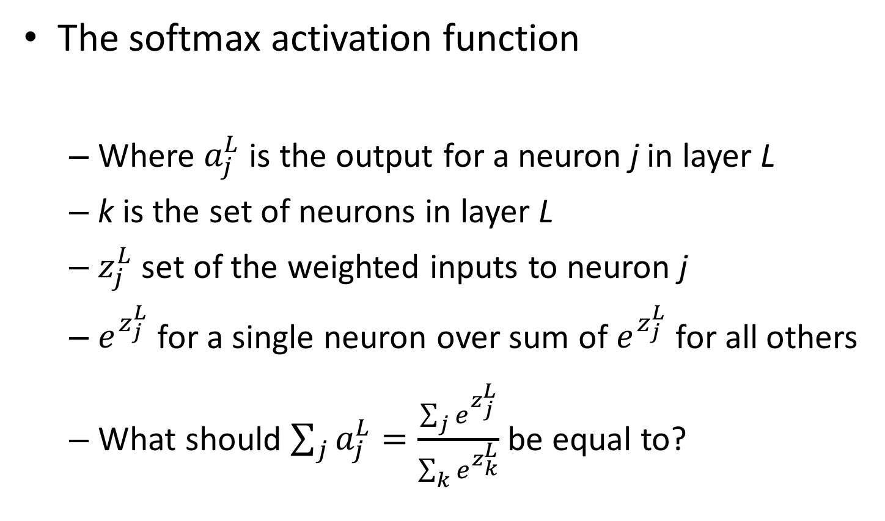
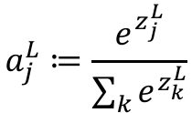
Another output function
The softmax activation function
Where $a_{j}^{L}$ is the output for a neuron j in layer L
k is the set of neurons in layer L
$z_{j}^{L}$ set of the weighted inputs to neuron j
$e^{z_{j}^{L}}$ for a single neuron over sum of $e^{z_{j}^{L}}$ for all others
What should $\sum_{j}{a_{j}^{L}}=\frac{\sum_{j}{e^{z_{j}^{L}}}}{\sum_{k}{e^{z_{k}^{L}}}}$ be equal to?
$$a_{j}^{L}≔\frac{e^{z_{j}^{L}}}{\sum_{k}{e^{z_{k}^{L}}}}$$
1

Slide 38
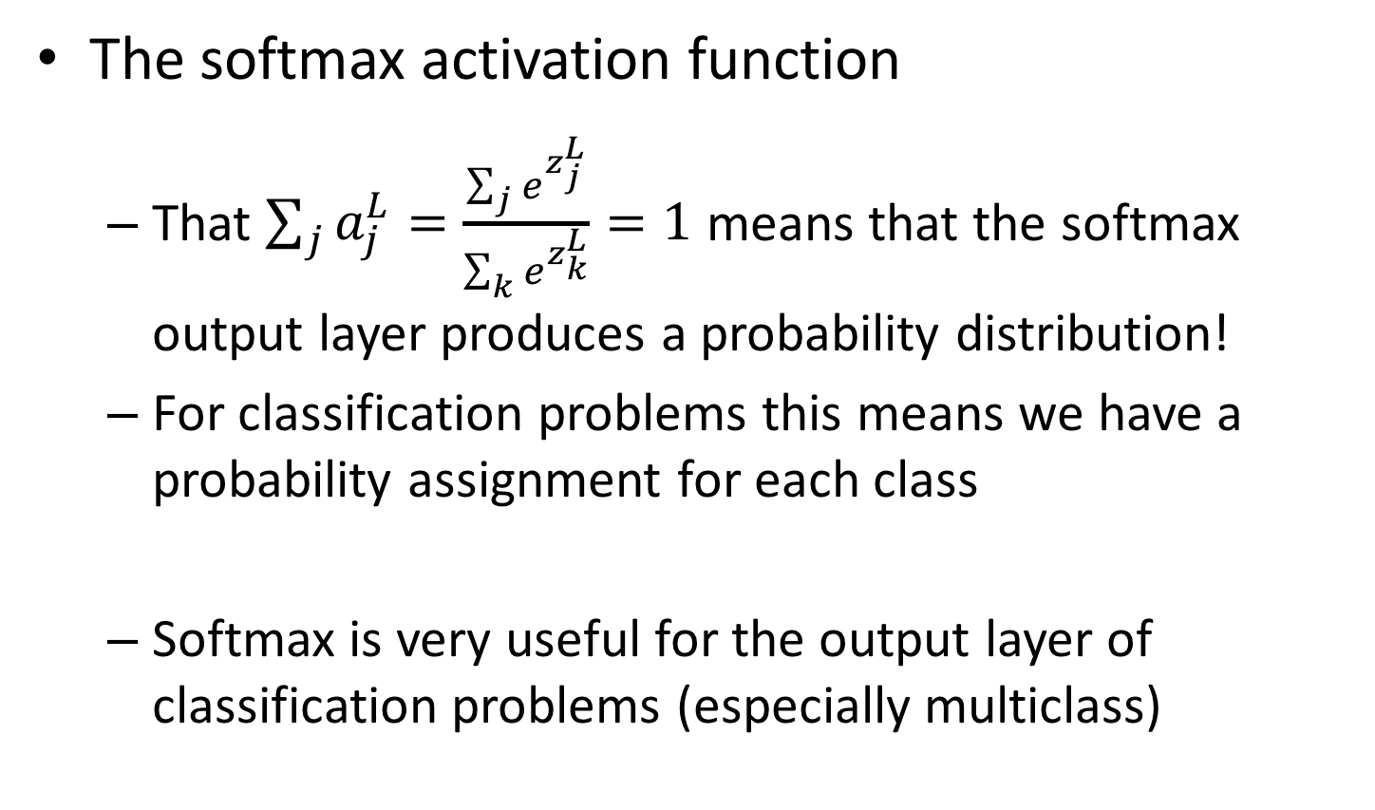
Another output function
The softmax activation function
That $\sum_{j}{a_{j}^{L}}=\frac{\sum_{j}{e^{z_{j}^{L}}}}{\sum_{k}{e^{z_{k}^{L}}}}=1$ means that the softmax output layer produces a probability distribution!
For classification problems this means we have a probability assignment for each class
Softmax is very useful for the output layer of classification problems (especially multiclass)
NEAT!

Slide 39
Monitoring training
With NN, we still do a test-train split
It is useful to plot the cost function or classification accuracy
Over training epochs
For train and validation
Data from keras on first 100k records in HCEPDB using only input and output layer.

Slide 40
Questions?
Other than why is that dog tangled in the blinds

Slide 41
Overfitting & neural networks
Neural networks can overfit
Regularization
L1
L2
Dropout
Early stopping

Slide 42
Regularization
Neural networks can overfit too!
This shouldn’t be a surprise
What can we do to combat overfitting?
This also shouldn’t be a surprise!

Slide 43
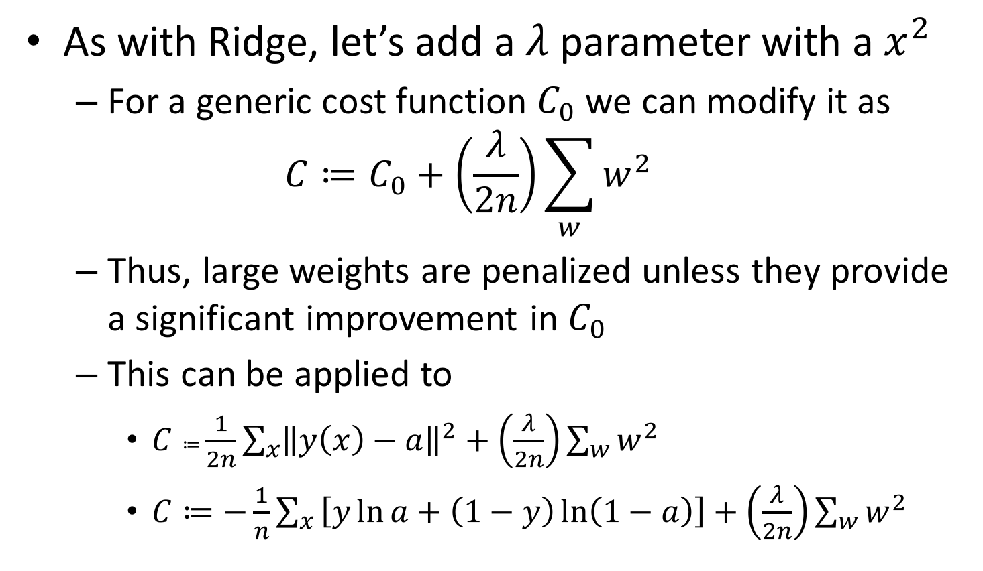
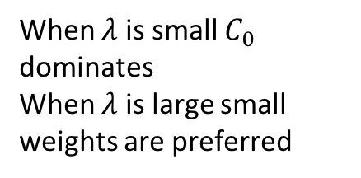
L2 Regularization
As with Ridge, let’s add a $λ$ parameter with a $x^{2}$
For a generic cost function $C_{0}$ we can modify it as
$$C≔C_{0}+\left(\frac{λ}{2n}\right)\sum_{w}{w^{2}}$$
Thus, large weights are penalized unless they provide a significant improvement in $C_{0}$
This can be applied to
$C≔\frac{1}{2n}\sum_{x}{{\left\|y\left(x\right)−a\right\|}^{2}}+\left(\frac{λ}{2n}\right)\sum_{w}{w^{2}}$
$C≔−\frac{1}{n}\sum_{x}{\begin{aligned}\left[y\ln{a}+\left(1−y\right)\ln\left(1−a\right)\right]+\left(\frac{λ}{2n}\right)\sum_{w}{w^{2}}\end{aligned}}$
When $λ$ is small $C_{0}$ dominates
When $λ$ is large small weights are preferred

Slide 44
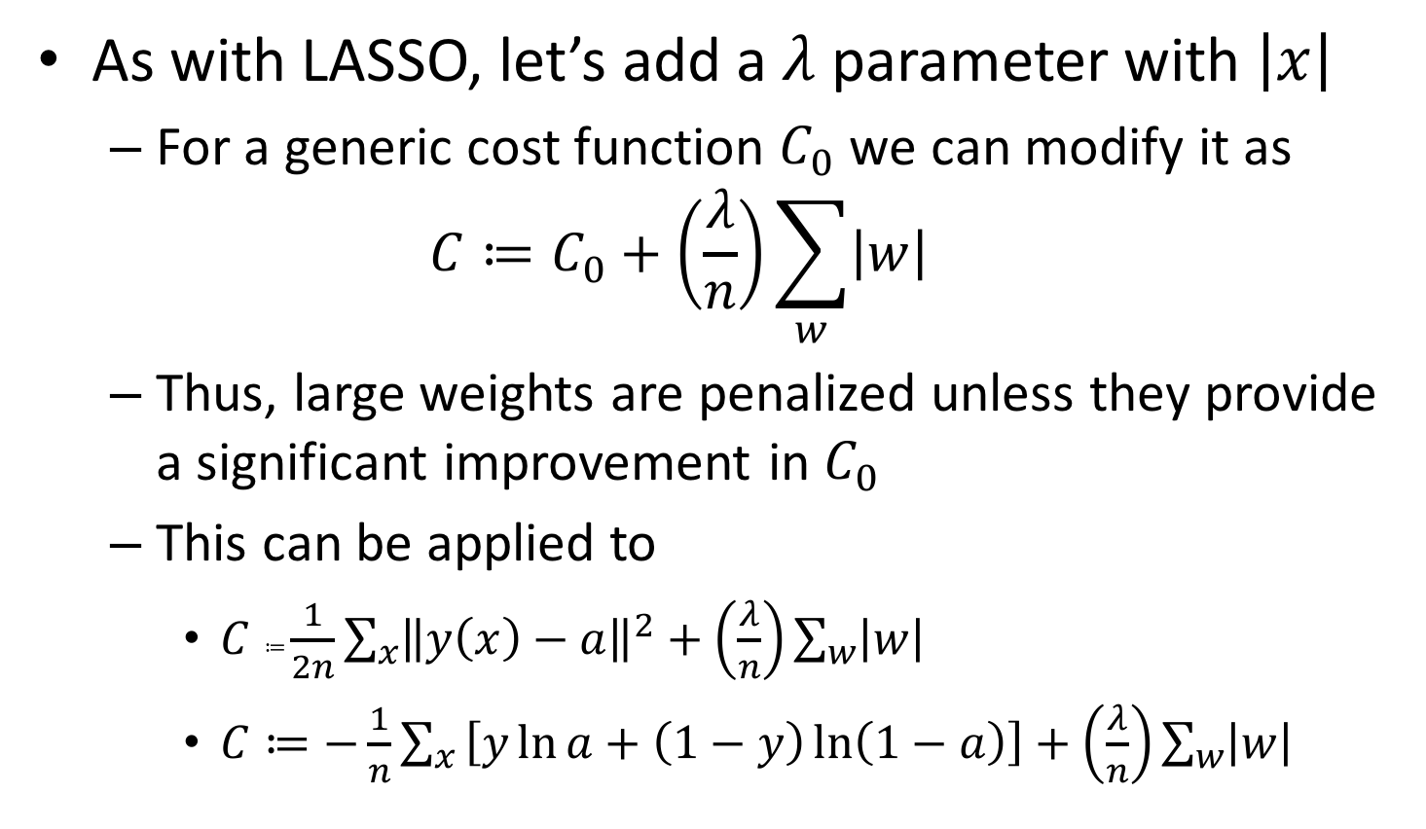
L1 Regularization
As with LASSO, let’s add a $λ$ parameter with $\left|x\right|$
For a generic cost function $C_{0}$ we can modify it as
$$C≔C_{0}+\left(\frac{λ}{n}\right)\sum_{w}{\left|w\right|}$$
Thus, large weights are penalized unless they provide a significant improvement in $C_{0}$
This can be applied to
$C≔\frac{1}{2n}\sum_{x}{{\left\|y\left(x\right)−a\right\|}^{2}}+\left(\frac{λ}{n}\right)\sum_{w}{\left|w\right|}$
$C≔−\frac{1}{n}\sum_{x}{\begin{aligned}\left[y\ln{a}+\left(1−y\right)\ln\left(1−a\right)\right]+\left(\frac{λ}{n}\right)\sum_{w}{\left|w\right|}\end{aligned}}$
When $λ$ is small $C_{0}$ dominates
When $λ$ is large small weights are preferred

Slide 45
L2 vs L1 regularization
Both reduce model complexity by shrinking w
L1: w shrink by a constant amount towards 0
L2: w shrink to 0 by an amount proportional to w
Thus
When |w| is small, L1 shrinkage >> L2 shrinkage
When |w| is large, L2 shrinkage >> L1 shrinkage
Therefore
L1 tends to concentrate weights in a small number of connections and others are driven to 0
L2 tends to shrink all weights

Slide 46
Dropout
Dropout is different from other regularization methods we have already encountered
L1 and L2 regularization alter the cost function
Dropout alters the network structure itself
At each epoch, a layer with dropout enabled will ‘dropout’ some percentage of nodes from the optimization step
That is, pretend those nodes and weights don’t exist

Slide 47
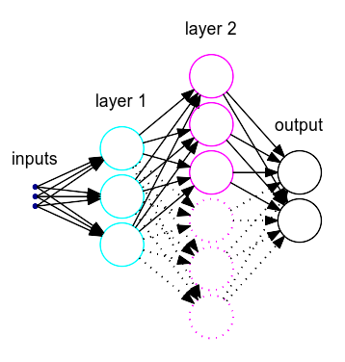
Dropout
At each epoch, ‘dropout’ some percentage of nodes from the optimization step
Epoch 1
Epoch 2
Dotted nodes are dropped out and their connections are ignored during forward and backpropagation.
Neural network model
Epoch 3

Slide 48
Dropout
Why does dropout reduce overfitting?
For any given dropout set, we are effectively fitting a different model
Effectively, we are fitting an ensemble of coexisting neural network models simultaneously
Overfitting errors of any given node set will average out over the entire model

Slide 49
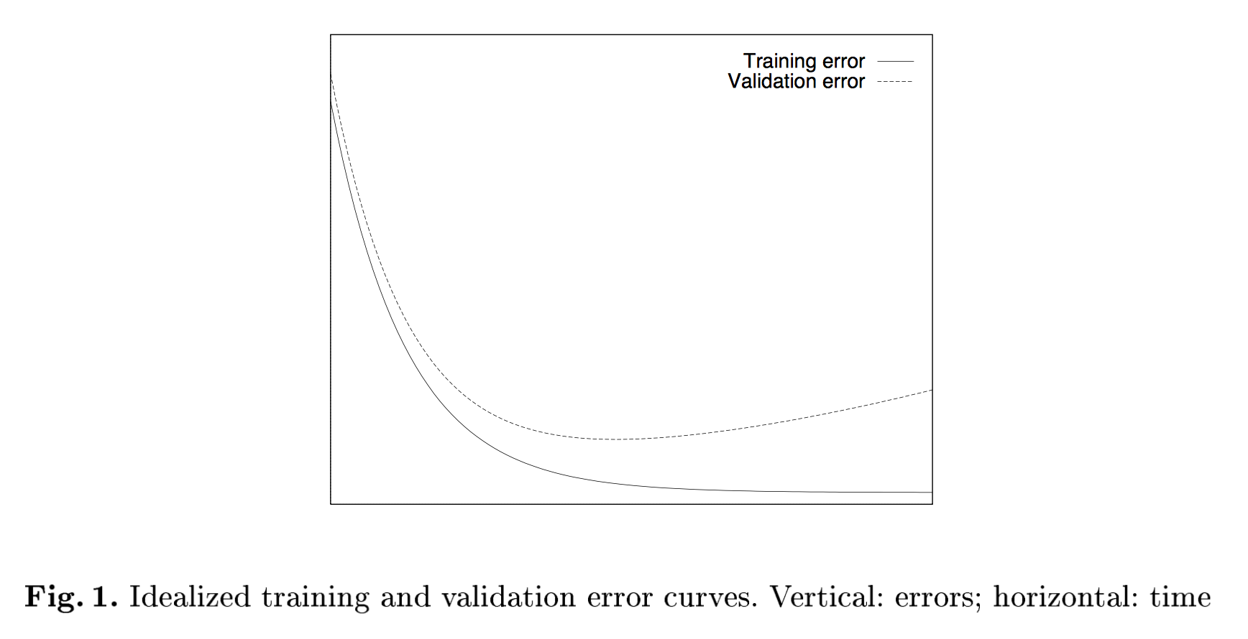
Early stopping
Consider the following train / validation error vs. training epoch
At some point, we begin to overfit to training data
Early Stopping – but when? Lutz Prechelt, 1997.

Slide 50
Early stopping
At some point, we begin to overfit to training data
When the validation error starts to go up, stop!
Early Stopping – but when? Lutz Prechelt, 1997.

Slide 51
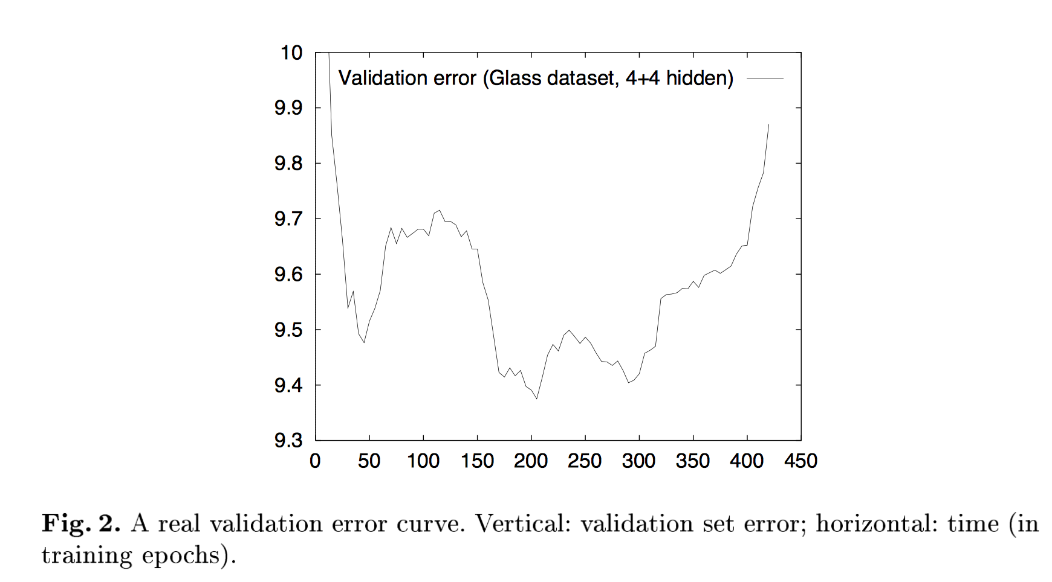
Early stopping
Rarely do curves look that good (another mythical elbow!)
Where do you stop here? 50? 205? 295?
Why is this jagged?
Early Stopping – but when? Lutz Prechelt, 1997.

Slide 52
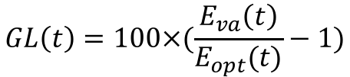
Early stopping
In practice there are lots of ways to do early stopping
Known as the stopping criterion
Some definitions
Let’s define a quantity known as generalization loss
$E_{tr}\left(t\right)$ is the value of loss / cost / error function at epoch t for the training data
$E_{va}\left(t\right)$ is the value of loss / cost / error function at epoch t for the validation data
$E_{te}\left(t\right)$ is the value of loss / cost / error function at epoch t for the test data
$E_{opt}\left(t\right)≔\min_{t^{′}<t}{E_{va}\left(t^{′}\right)}$ is the lowest validation set loss obtained up to epoch t
$$GL\left(t\right)=100×(\frac{E_{va}\left(t\right)}{E_{opt}(t)}−1)$$
What are some features of GL?

Slide 53
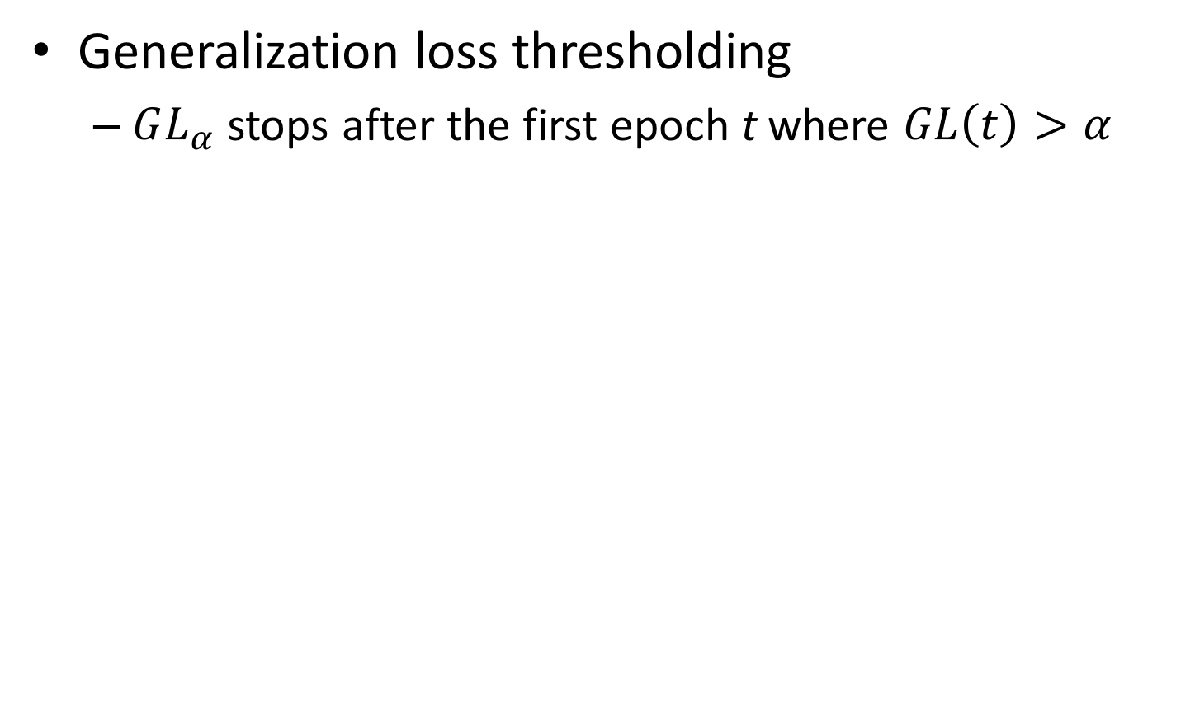
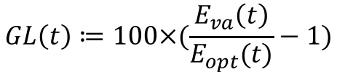
Early stopping
Generalization loss thresholding
$GL_{α}$ stops after the first epoch t where $GL\left(t\right)>α$
$$GL\left(t\right)≔100×(\frac{E_{va}\left(t\right)}{E_{opt}(t)}−1)$$
System is still training rapidly and is not yet over fitting!
Early Stopping – but when? Lutz Prechelt, 1997.

Slide 54
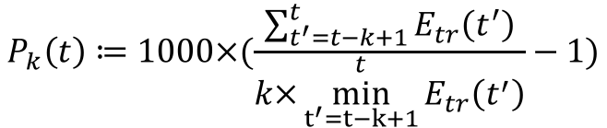
Early stopping
How can we avoid stopping if the system is still ‘equilibrating’?
Define a windowed training ‘progress’ function
Where k is a window size where n is divisible by k
How much bigger was the average training error over the minimum training error for a window of size k?
$$P_{k}\left(t\right)≔1000×(\frac{\sum_{t^{′}=t−k+1}^{t}{E_{tr}\left(t^{′}\right)}}{k×\overset{t}{\min_{t^{′}=t−k+1}}{E_{tr}\left(t^{′}\right)}}−1)$$

Slide 55
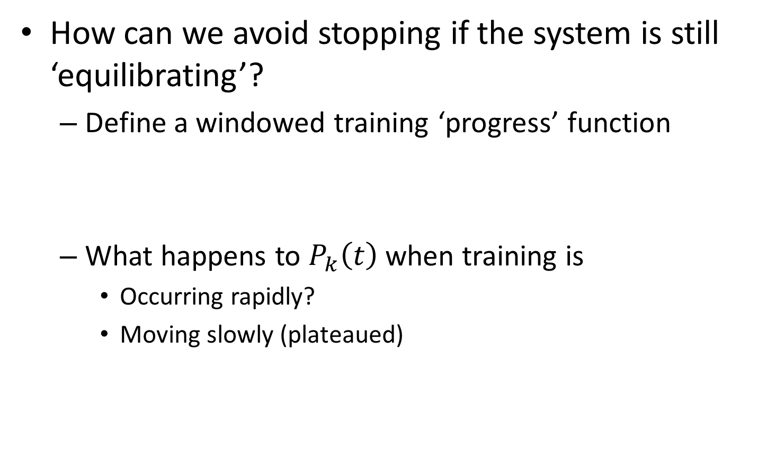
Early stopping
How can we avoid stopping if the system is still ‘equilibrating’?
Define a windowed training ‘progress’ function
What happens to $P_{k}\left(t\right)$ when training is
Occurring rapidly?
Moving slowly (plateaued)
$$P_{k}\left(t\right)≔1000×(\frac{\sum_{t^{′}=t−k+1}^{t}{E_{tr}\left(t^{′}\right)}}{k×\overset{t}{\min_{t^{′}=t−k+1}}{E_{tr}\left(t^{′}\right)}}−1)$$
Take two minutes and discuss this at your table

Slide 56
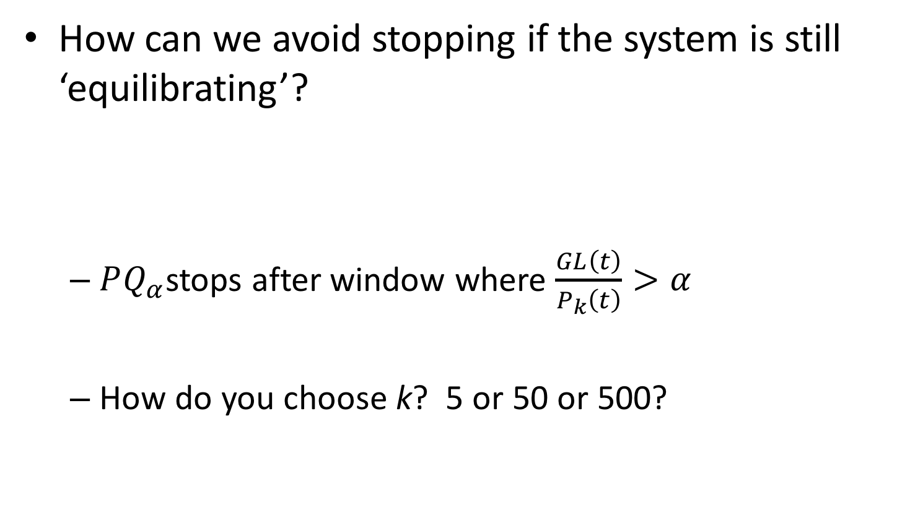
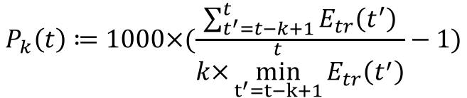
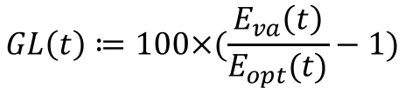
Early stopping
How can we avoid stopping if the system is still ‘equilibrating’?
$PQ_{α}$stops after window where $\frac{GL\left(t\right)}{P_{k}\left(t\right)}>α$
How do you choose k? 5 or 50 or 500?
$$GL\left(t\right)≔100×(\frac{E_{va}\left(t\right)}{E_{opt}(t)}−1)$$
$$P_{k}\left(t\right)≔1000×(\frac{\sum_{t^{′}=t−k+1}^{t}{E_{tr}\left(t^{′}\right)}}{k×\overset{t}{\min_{t^{′}=t−k+1}}{E_{tr}\left(t^{′}\right)}}−1)$$

Slide 57
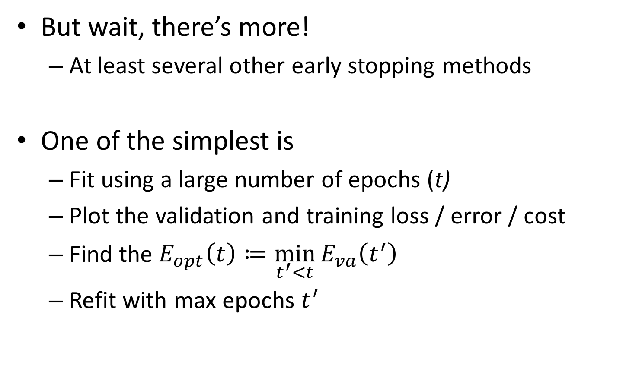
Early stopping
But wait, there’s more!
At least several other early stopping methods
One of the simplest is
Fit using a large number of epochs (t)
Plot the validation and training loss / error / cost
Find the $E_{opt}\left(t\right)≔\min_{t^{′}<t}{E_{va}\left(t^{′}\right)}$
Refit with max epochs $t^{′}$
Gotta love simple!

Slide 58
Avoiding overfitting
Dropout final thoughts
It reduces ‘complex co-adaptations’ of neurons and forces them to rely on more robust features¹
Results in a less ‘complex’ network
The general idea is to simplify the model by
Driving weights to 0
Reducing over complex co-adaptations
Using ’smeared ensembles’
Stopping training before overfitting begins
1. Krizhevsky, Sutskever, Hinton (2012) NIPS

Slide 59
Questions?

Slide 60
Python time! WEEEE!
Grab the Python notebook from the syllabus
Be sure to have done the setup procedure in slack
Run `jupyter notebook` in your virtual environment
conda create -n keras
source activate keras
conda install -c conda-forge keras
conda install ipython
conda install jupyter
conda install pandas
conda install scipy
conda install seaborn
conda install scikit-learn

